Slide 1
Browsing History

Slide 2
Content
Search for commits (by author, data, message, etc.)
View a commit
Restore your project to an earlier point.
Compare commits
View the history of a file
Find a bad commit that introduced a bug

Slide 3
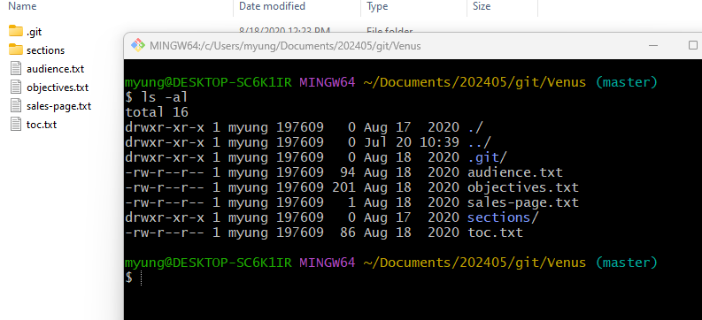
Getting a Repository
Download Venus.zip into a directory and unzip it.

Slide 4
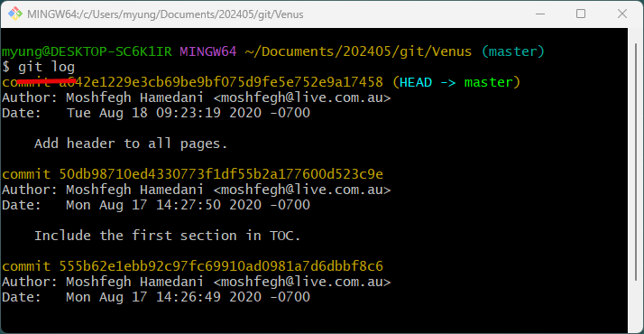
Viewing the History

Slide 5
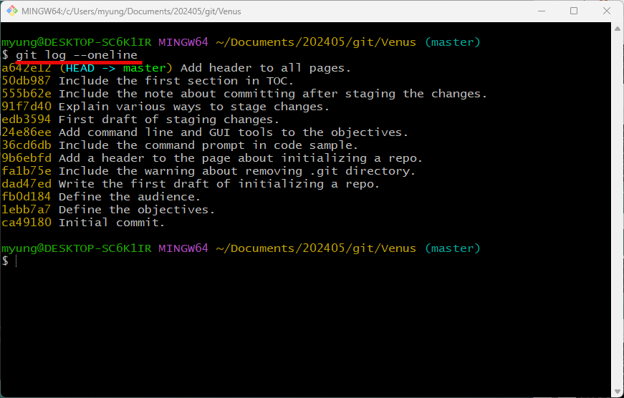

Slide 6
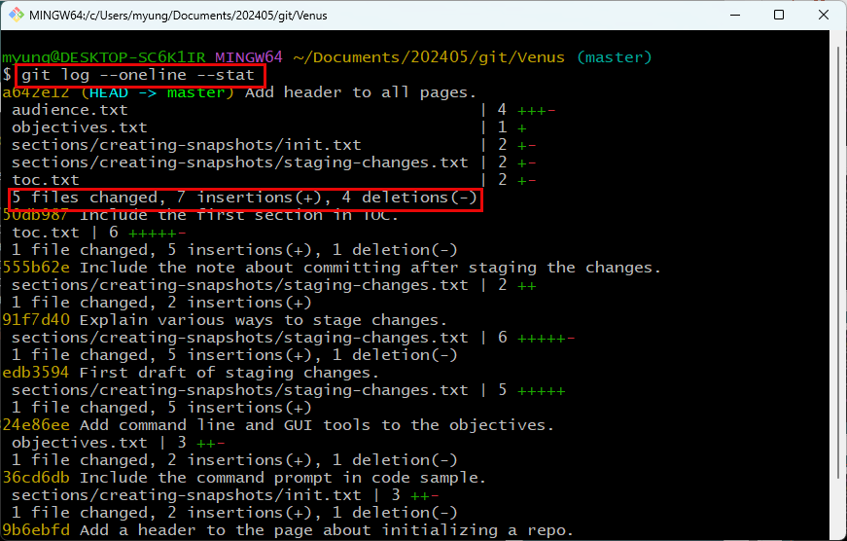
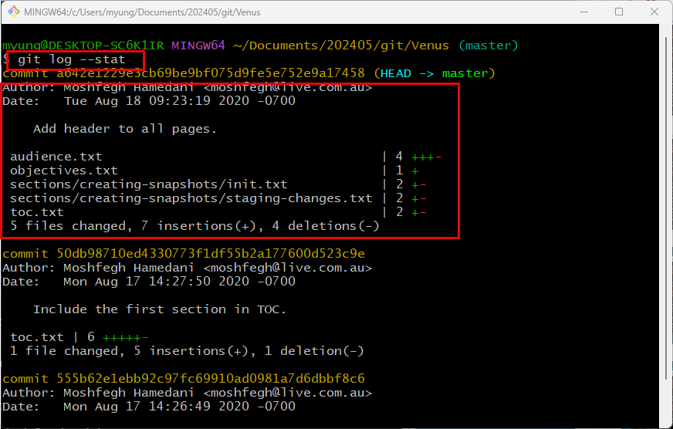

Slide 7
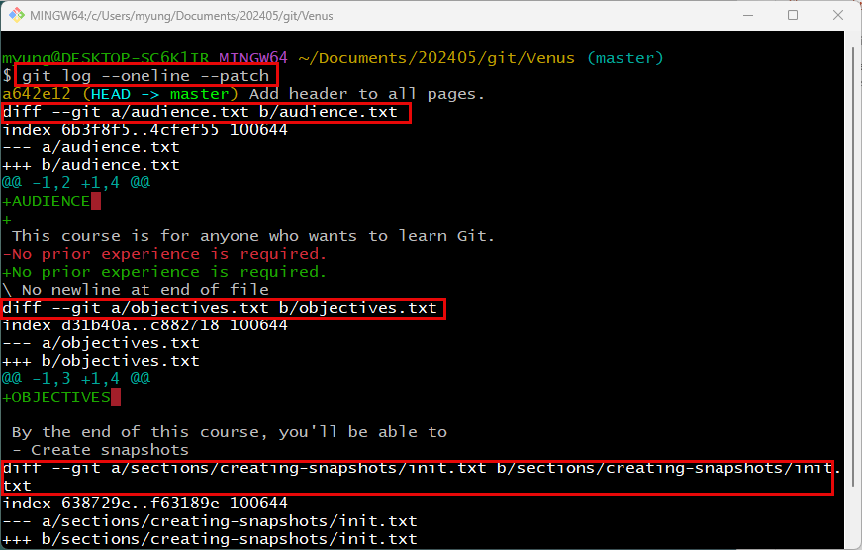

Slide 8
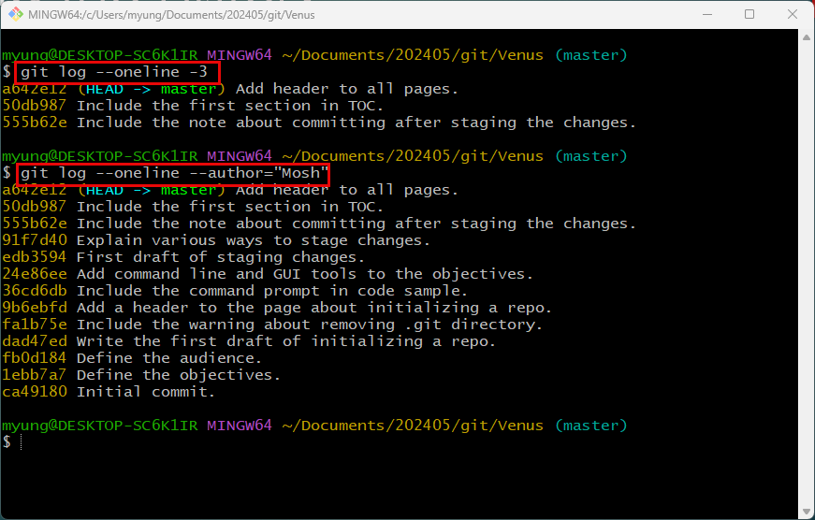
Filtering the History
Last three commits
Search by author

Slide 9
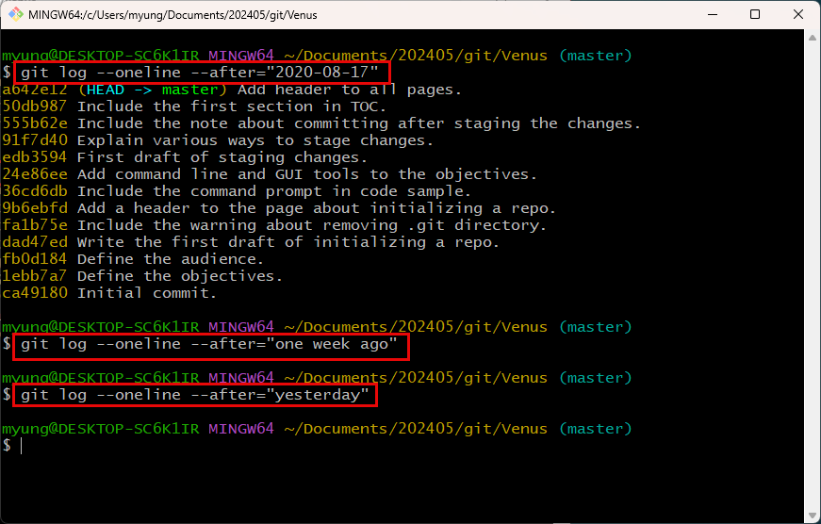

Slide 10
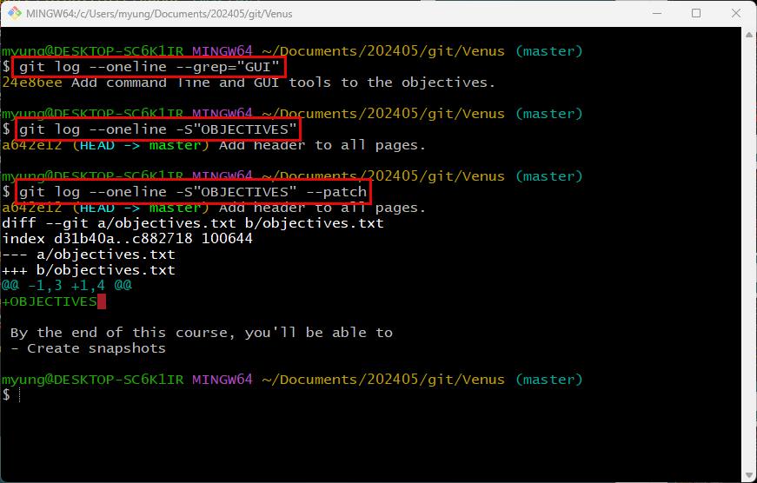

Slide 11
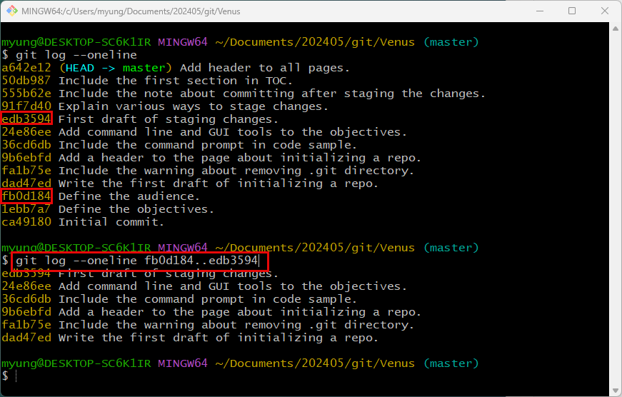

Slide 12
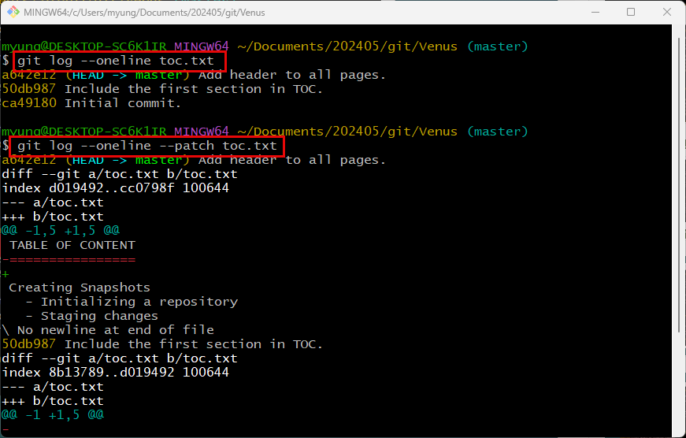
All commits that modified toc.txt.

Slide 13
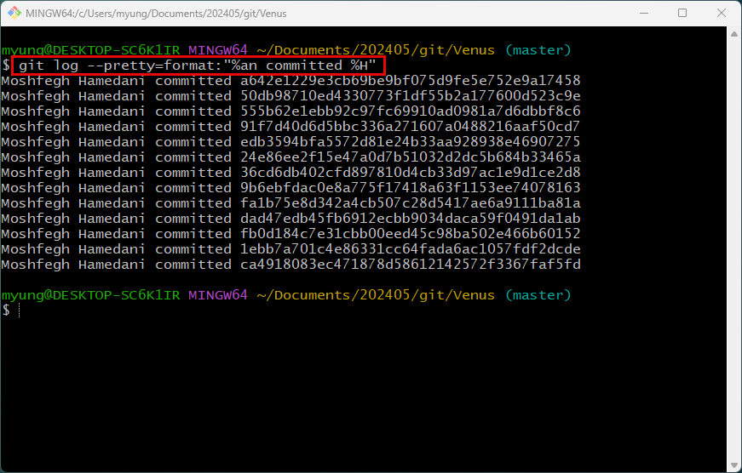
Formatting the Log Output
%an – author name
%H – hash code of each commit

Slide 14
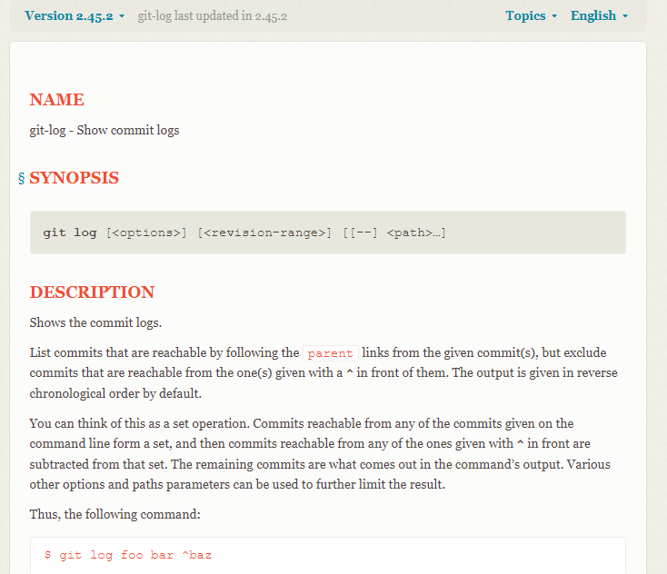
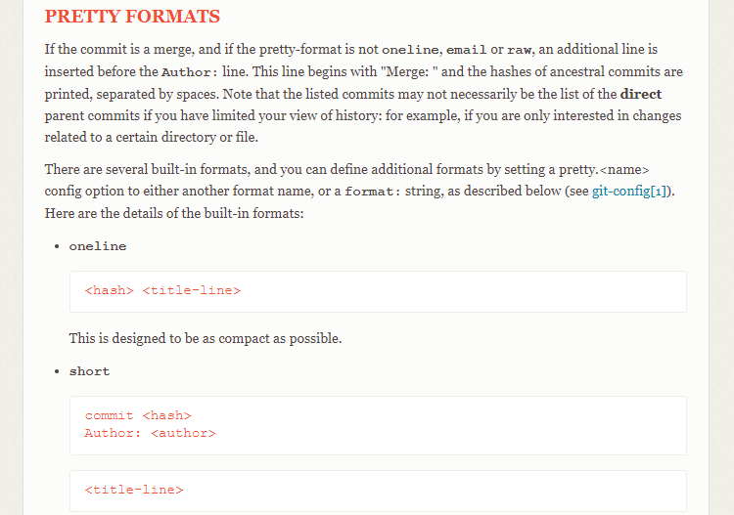
https://git-scm.com/docs/git-log

Slide 15
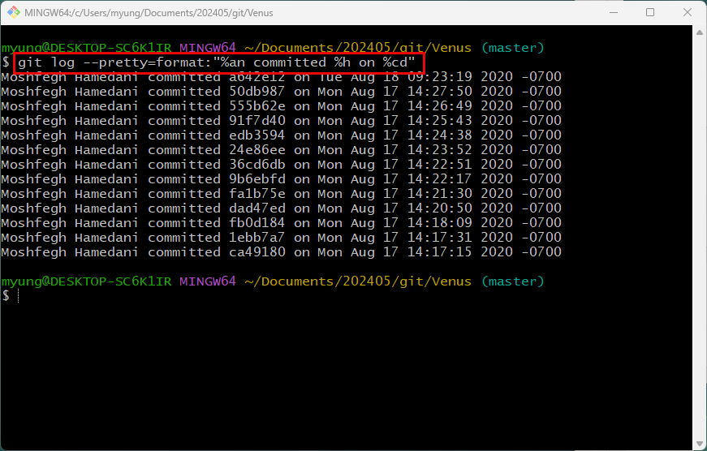
%an – author name
%h – hash code of each commit (short form)
%cd – commit date

Slide 16
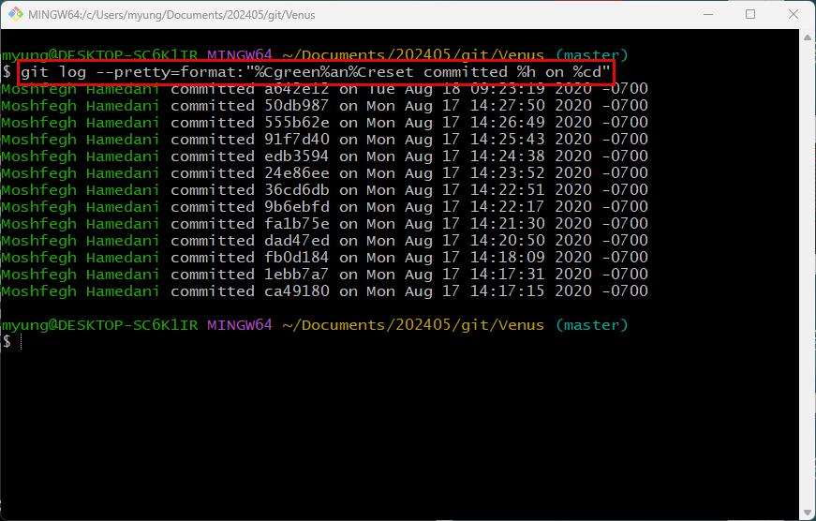
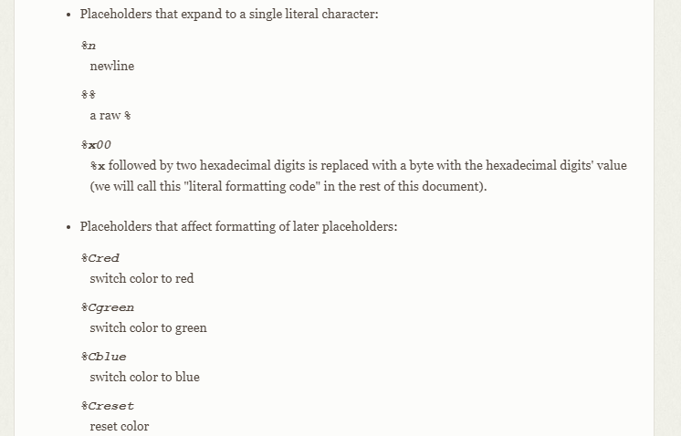
%Cgreen – change color to green
%Creset – reset color

Slide 17
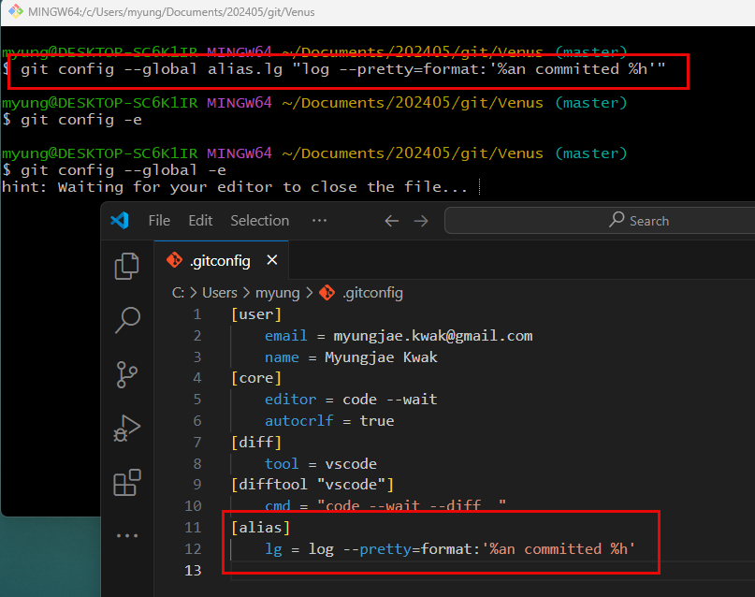
Creating Aliases

Slide 18
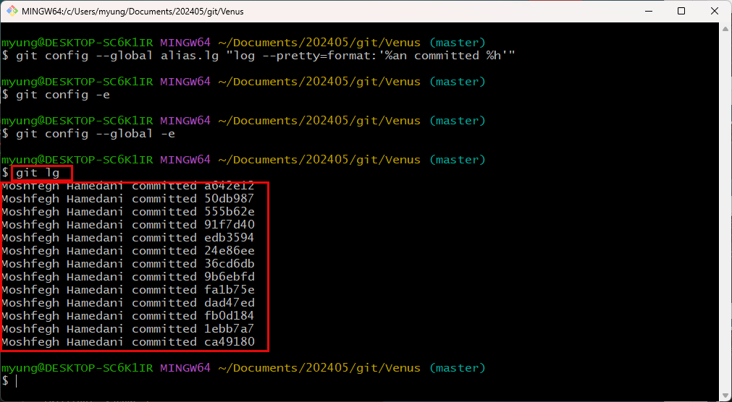

Slide 19
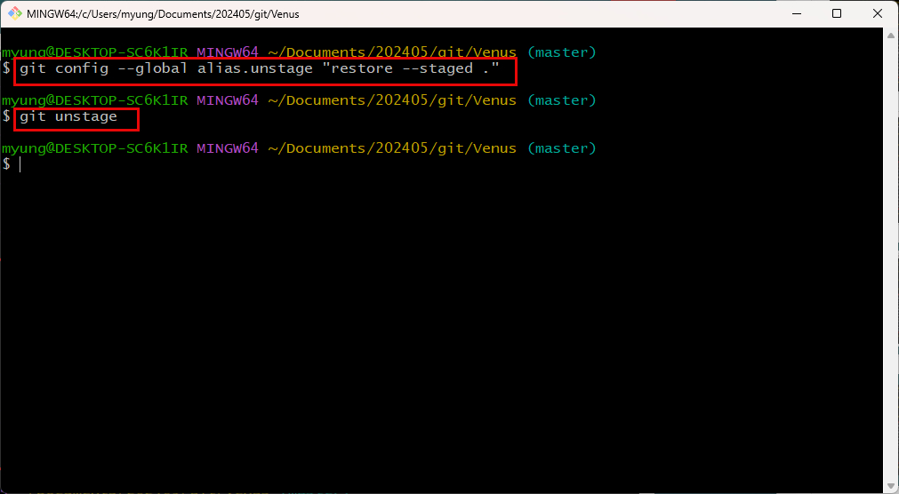
This alias will unstage all changes.

Slide 20
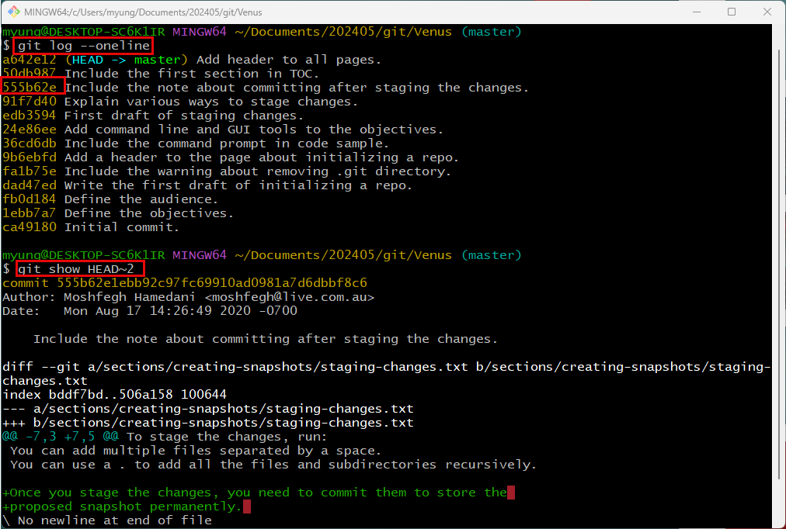
Viewing a Commit

Slide 21
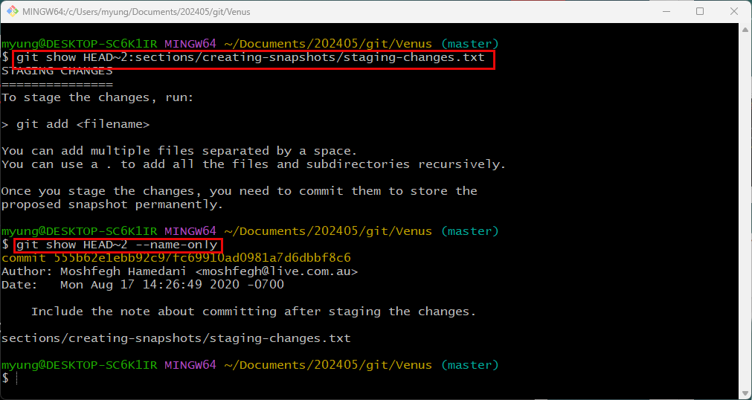
It will show the final version of the file.
It will show only the file name.
--name-status option shows the status of the file.

Slide 22
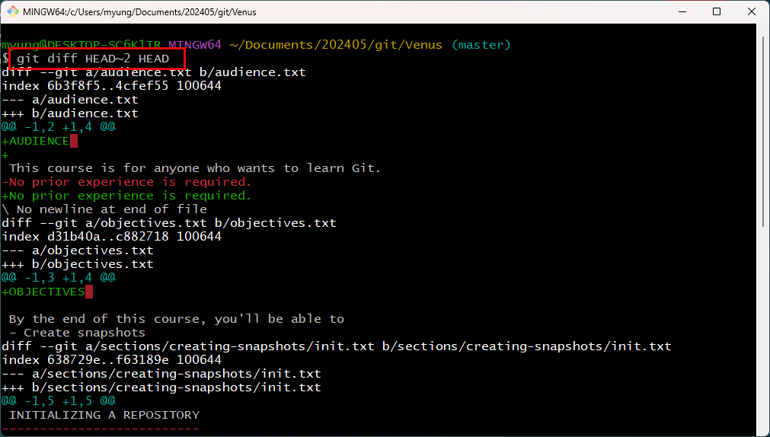
Viewing the Changes Across Commits
Show the differences between two commits.

Slide 23
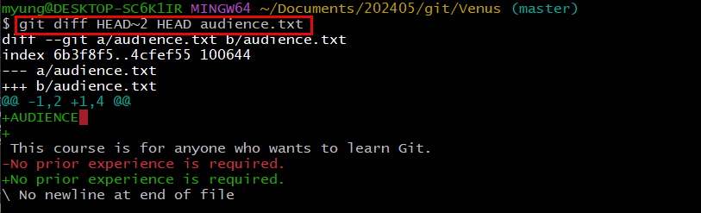
To see the changes of a specific file.

Slide 24
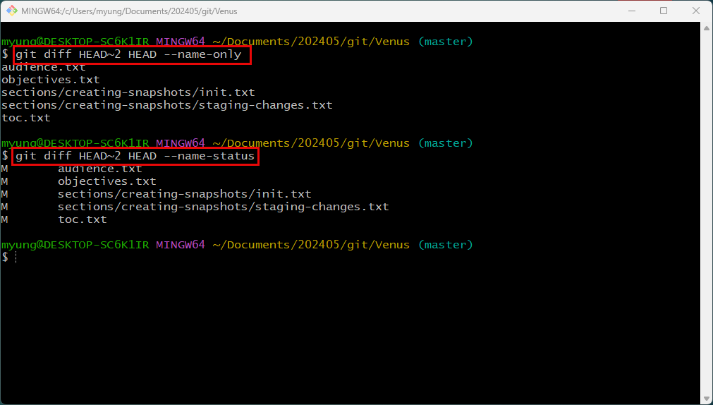

Slide 25
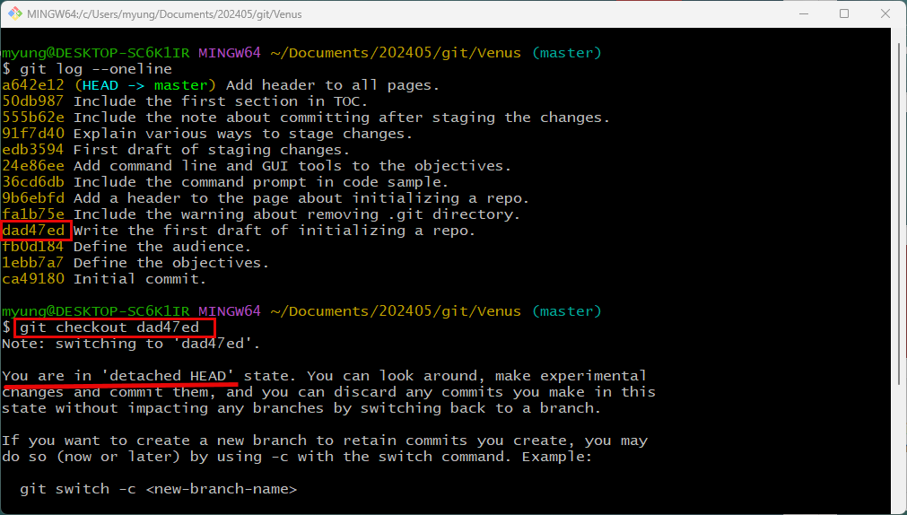
Checking Out a Commit

Slide 26
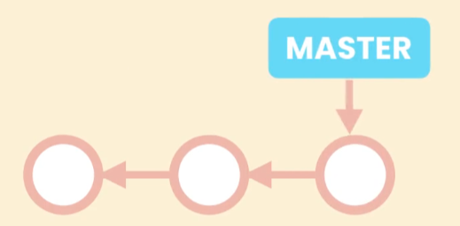
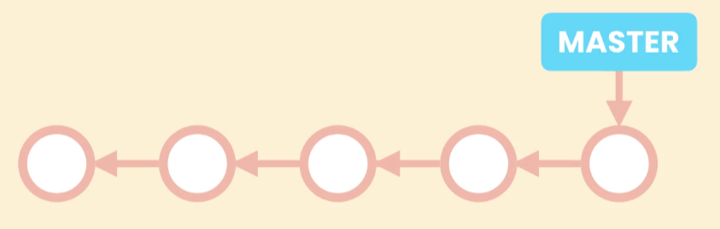
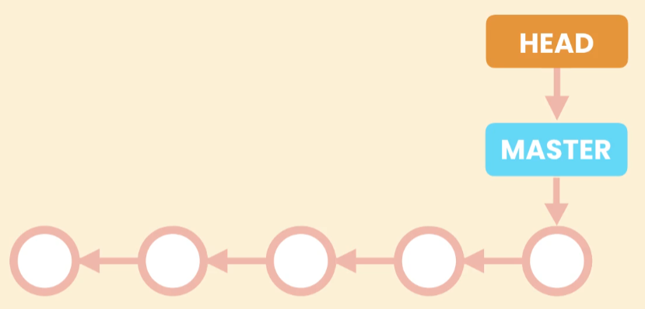
In git, each snapshot refers to the previous snapshot.
master is pointing the current main line of work.
In git, there is another special pointer, and it is usually pointing master as you can see in the previous slide.

Slide 27
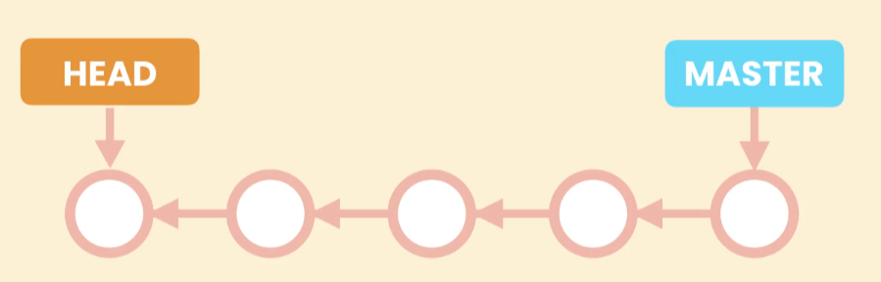
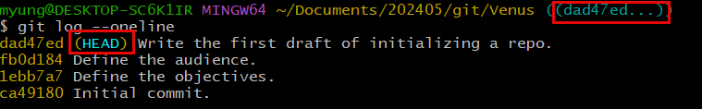
If you checkout a certain commit, HEAD is pointing the checked-out commit and you are in detached HEAD state.
You only can see the commit and cannot change.

Slide 28
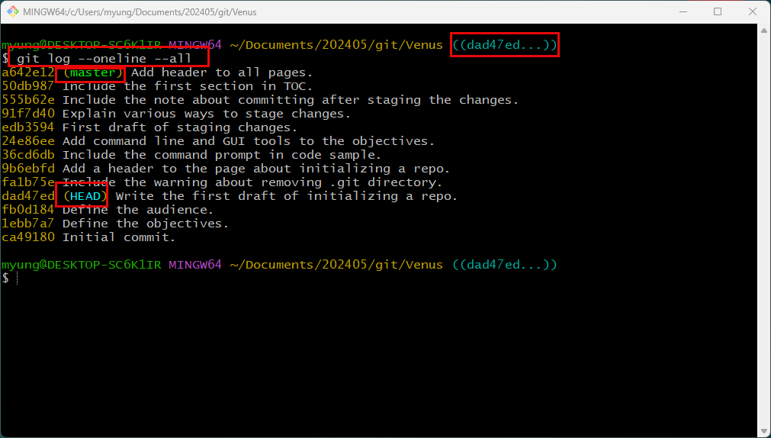

Slide 29
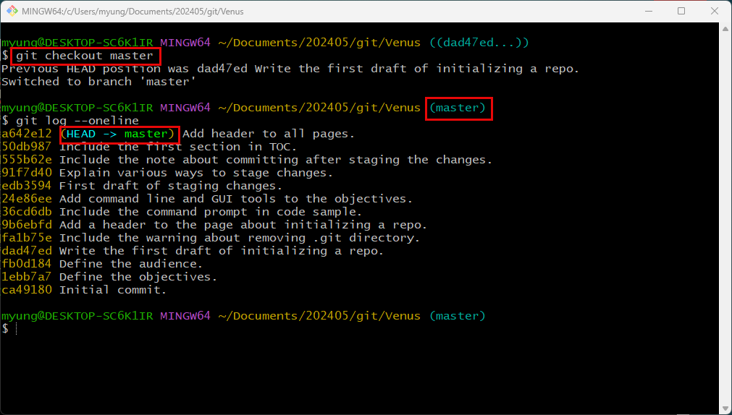
Change back to master

Slide 30
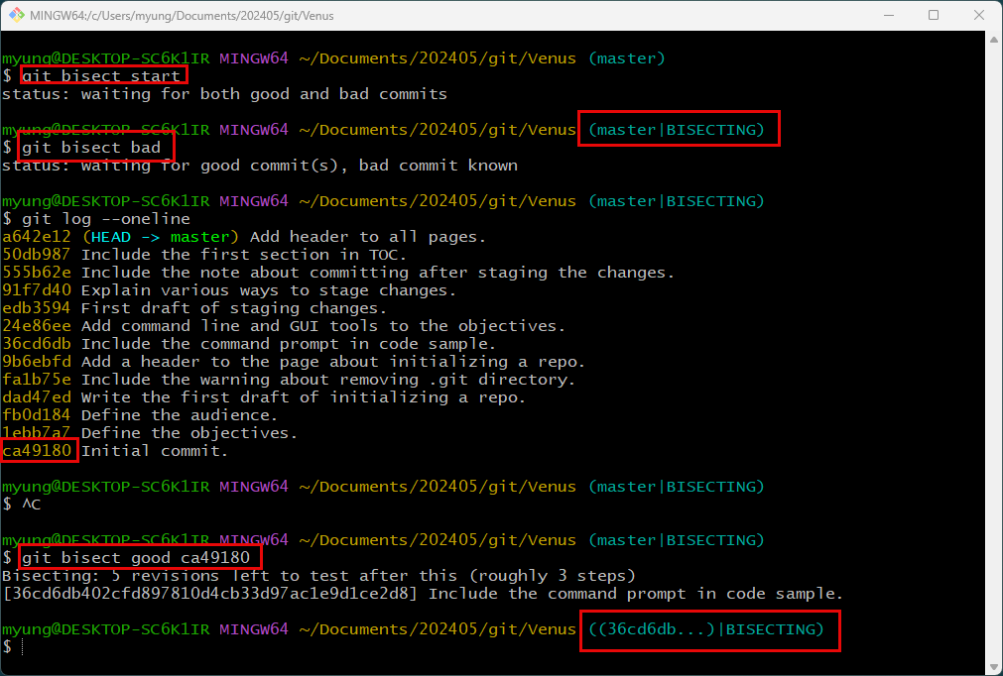
Finding Bugs Using Bisect
Assume that the current master commit has a bug.
ca49180 is the last known good commit.

Slide 31
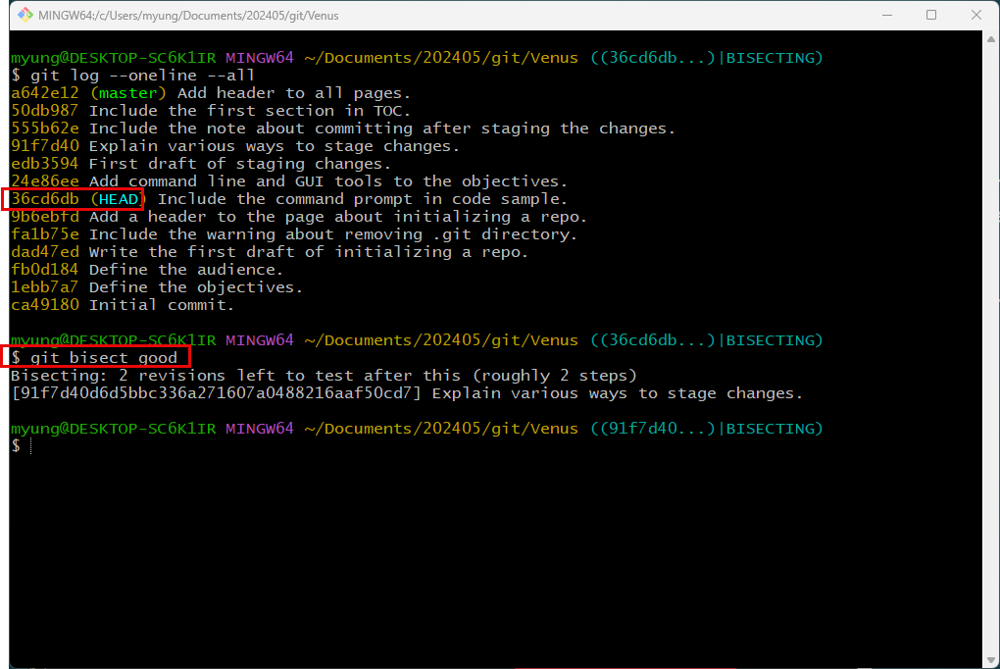
If the first half commits don’t have the bud, you can set the commit as a good. Then examine the other half.

Slide 32
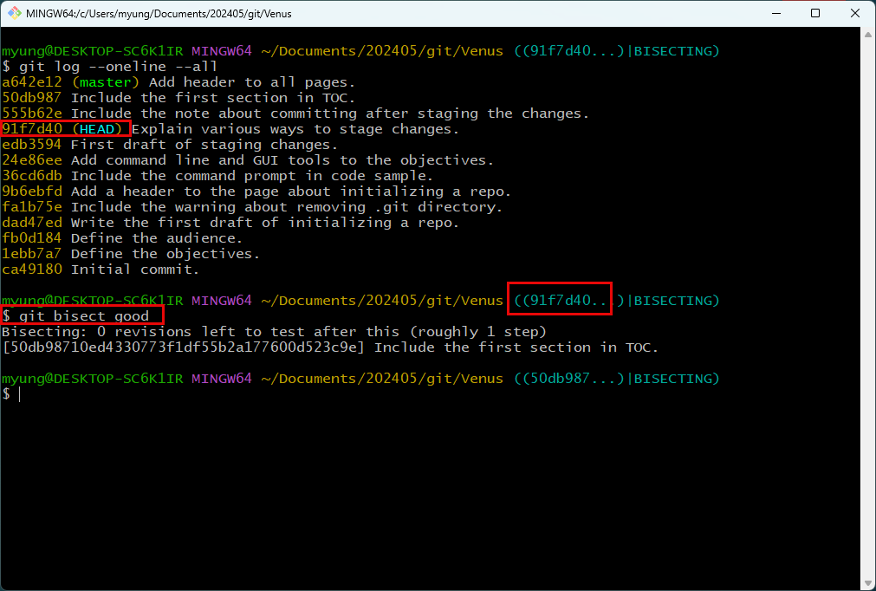

Slide 33
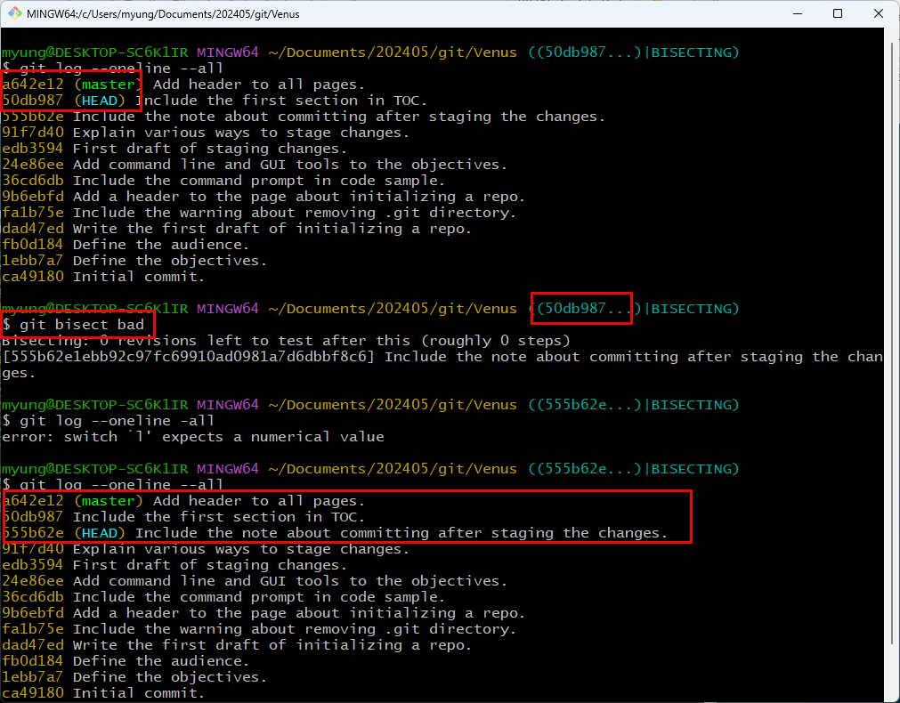
Set 50db987 as a bad commit.
It will make HEAD point 555b62e.

Slide 34
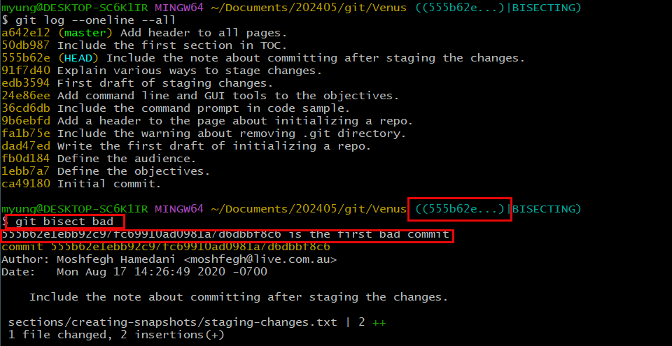
When you are done, you can reset the bisect.

Slide 35
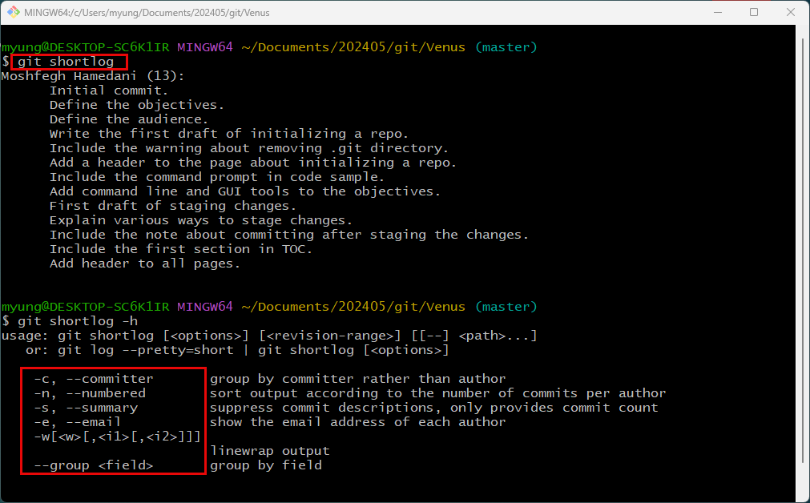
Finding Contributors Using Shortlog

Slide 36
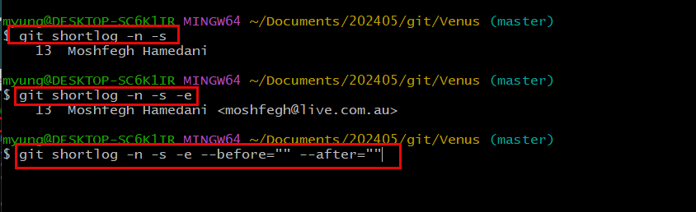

Slide 37
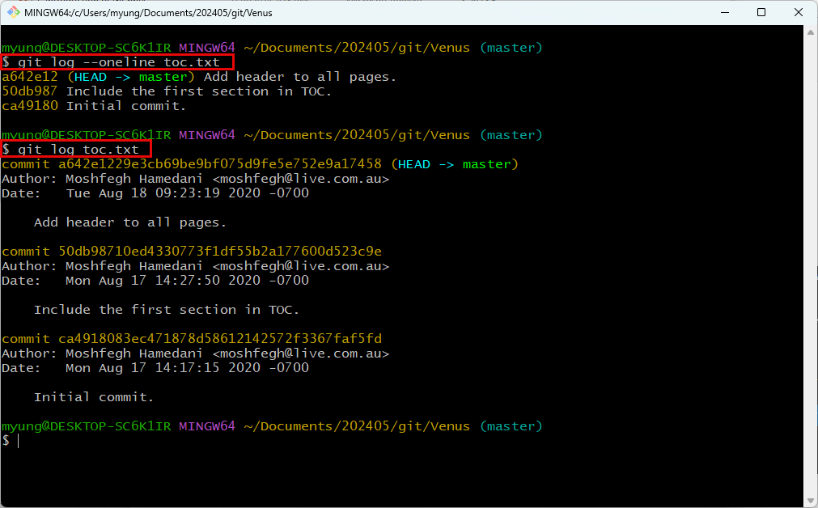
Viewing the History of a File

Slide 38
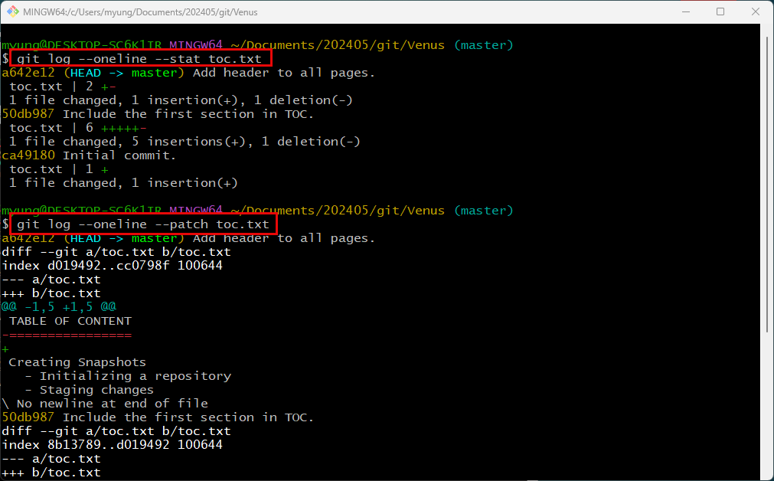

Slide 39
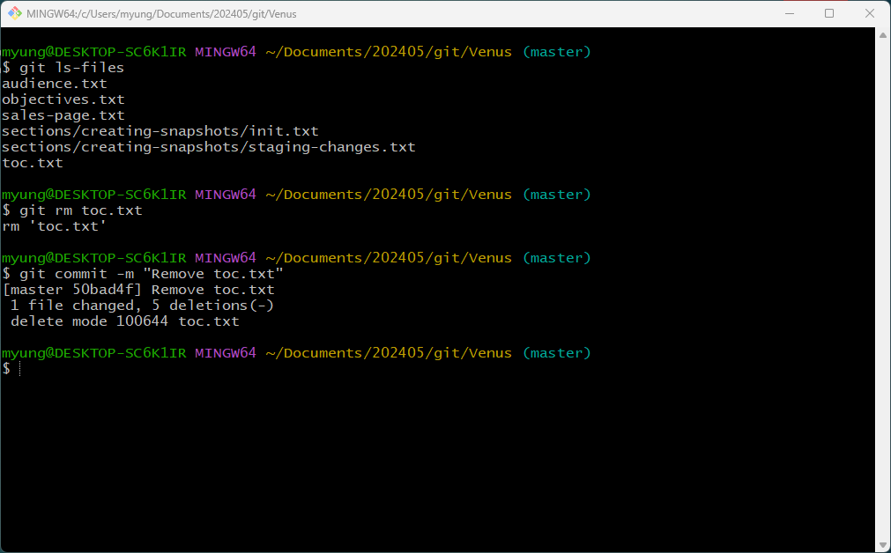
Restoring a Deleted File
Accidently deleted toc.txt and committed it.

Slide 40
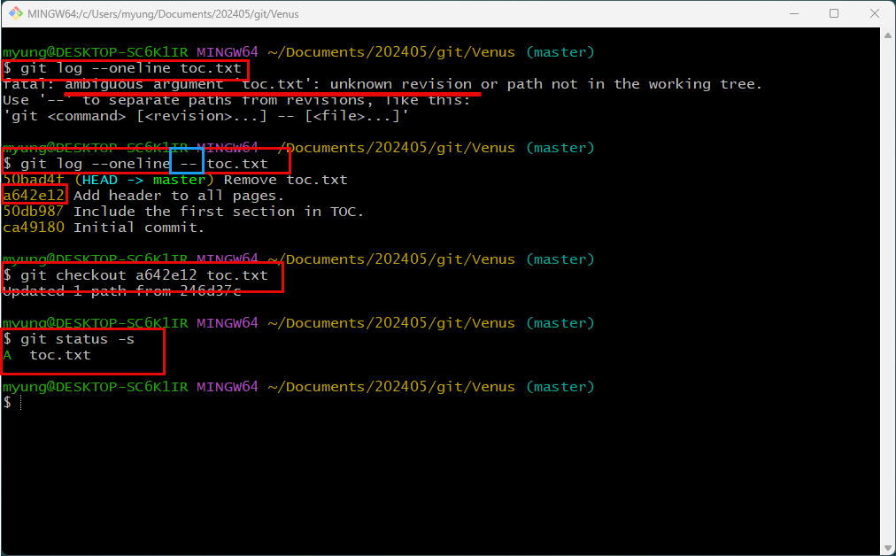
Snapshot a64e12 has the toc.txt file.
Checkout the file from a64e12.

Slide 41
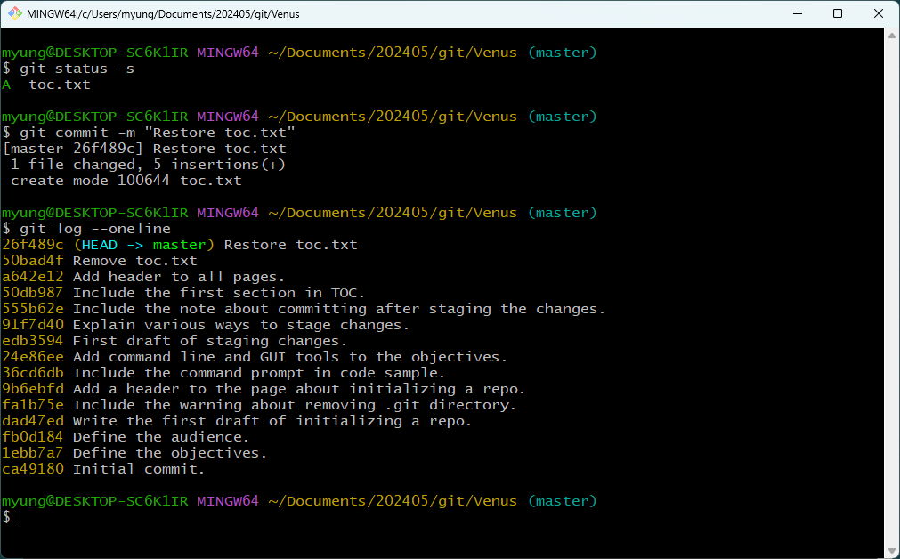
By committing the checked-out file, you can restore the file.

Slide 42
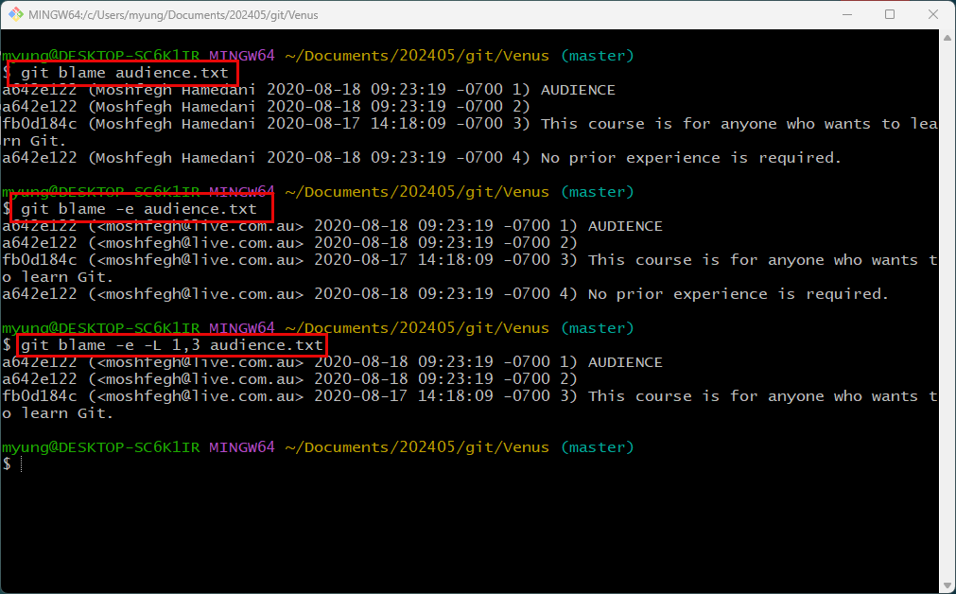
Finding the Author of Line using Blaming
If audience.txt is causing a problem, …
To see author’s email
To see the first three commits

Slide 43
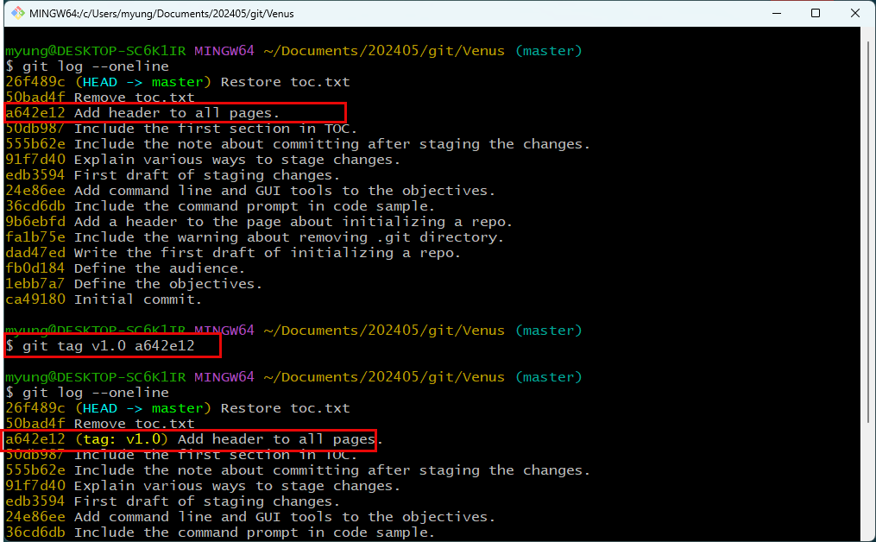
Tagging

Slide 44
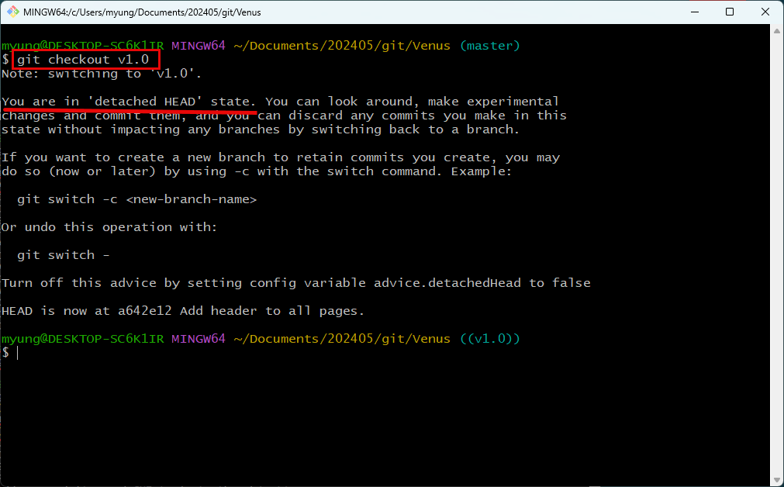
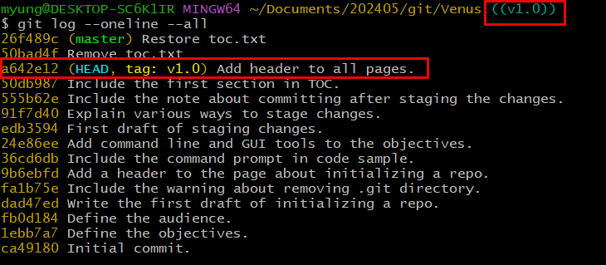

Slide 45
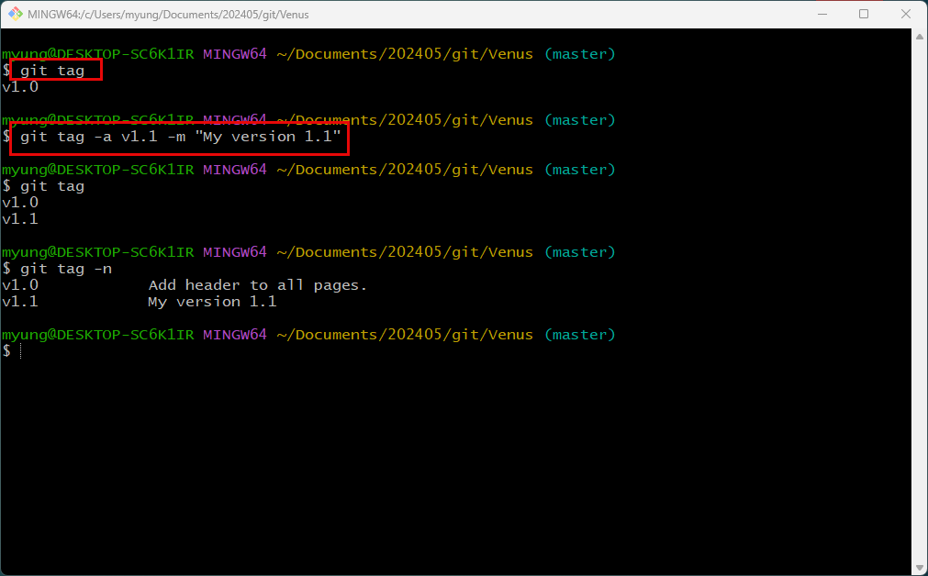
List all tags
Create a custom tag
List all tags with various options.

Slide 46


Slide 47

Delete a tag

Slide 48

Browsing History Using VSCode and GitLens Extension.

Slide 49


Slide 50
Browsing History using GitKraken

Slide 51

Summary

Slide 52


Slide 53


Slide 54


Slide 55
Exercises

